Slide 1

Python Workshop
Session 3

Slide 2
Covering Today
Handling Strings
Sorting Algorithms Advanced
Lists and Collections Advanced

Slide 3
Handling Strings
Def = A string is a sequence of characters enclosed in single, double or triple quotes
“Hello World”, ‘’’Multi-line string’’’
Basic operations
Concatenation – Joining two strings together with + operator
“Hello” + “ World” -> “Hello World”
Repetition – Repeating a string using the * operator
“ha” * 3 -> “hahaha”

Slide 4
Handling Strings - Continued
Accessing string elements
The first element in string has index of 0
The last element has an index of length of string – 1
Example
Var = “Python”
Accessing first element -> Var[0] = ‘P’
Accessing last element -> Var[5] = ‘n’
String Methods
Lowercase – variable_name.lower()
Uppercase – variable_name.upper()
Strip (remove whitespace) – variable_name.strip()
Replace – variable_name.replace(to_replace, to_add)
Split (Split a string into a list if it) – variable_name.split(separator)

Slide 5
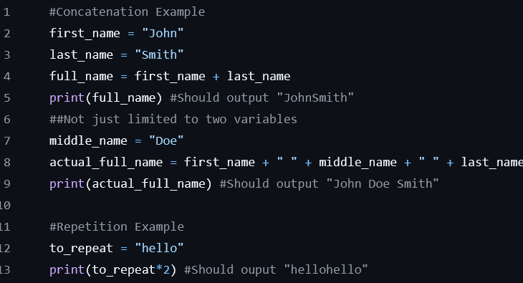
Handling Strings – Example 1

Slide 6
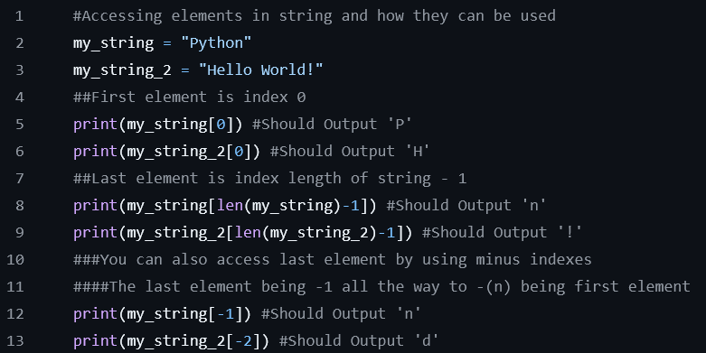
Handling Strings – Example 2

Slide 7
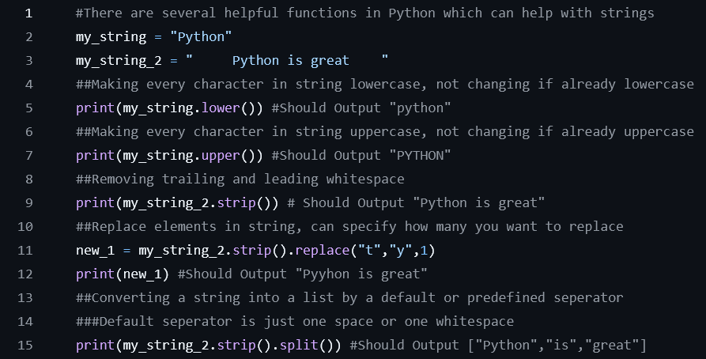
Handling Strings – Example 3

Slide 8
Sorting Algorithms Advanced
Sorting algorithms are essentials in the daily life of a programmer as it allows you to make tasks easier and ensure accuracy
As you progress more through your career and get more confident you will begin to use different sorting algorithms depending on the use-case
For example, if you just want a quick fix solution which will work, it might not be the best but its good enough you might use a bubble sort. However, if the space and time complexity do matter you might use a radix or bucket sort

Slide 9
Sorting Algorithm Bubble Sort Animation

Slide 10
Sorting Algorithm Merge Sort Animation

Slide 11

Sorting Algorithm Multiple Animations

Slide 12
Sorting Algorithms Advanced – Use case
Given a list of size n, return the maximum number
or
Given a list of size n, return the 3 maximum numbers
There are two ways to solve this problem
Iterate through the list and compare the current element to the current maximum element and swap them if they are both size
This works for one maximum but if you want an x number of the maximum numbers then this methods is inefficient
Sort the algorithm using any sorting algorithm in ascending order
Although this method takes longer if there are multiple maximum values you want it works better

Slide 13
Lists and Collections advanced

